Slide 1
Google Business Intelligence Certificate: Cyclistic Exemplar
File created on: 4/17/2025 4:10:43 PM

Slide 2
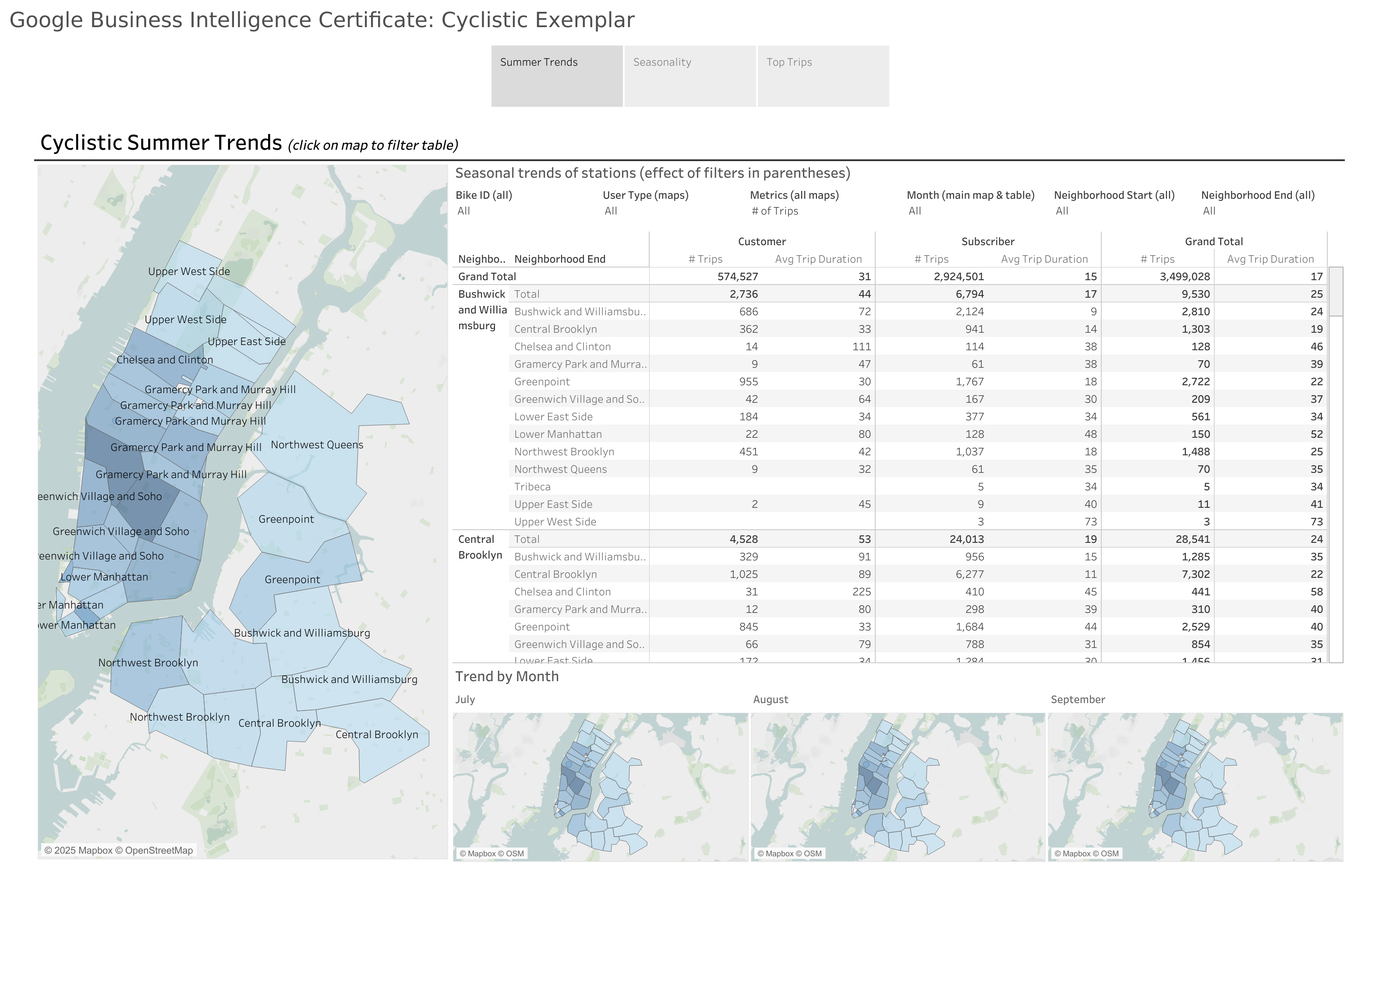

Slide 3
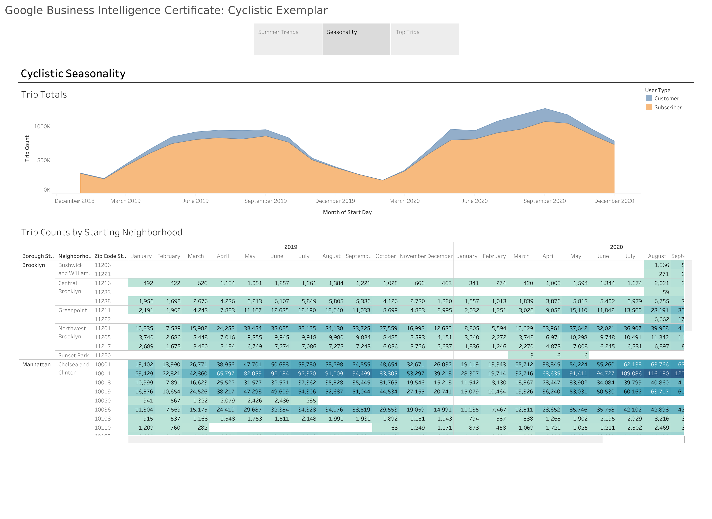

Slide 4
